Slide 1

Programming III

Slide 2
Introduction to Functions
Most Important Programming Skill in R
Functions in R
Take Inputs
Do Calculations
Produce Outputs
Control Structures Such as “If-else” Statements and Loops are Used in Functions
Advantages
Memorable Names
Code Updates Occur in 1 Place
Makes Code Accessible by All

Slide 3
Built-in R Functions
Before Writing a Function, Always Search for a Function That Does What You Want
To See What a Function Does:
To Understand How the Function Works, Algorithmically:
?dplyr::lag
dplyr::lag

Slide 4
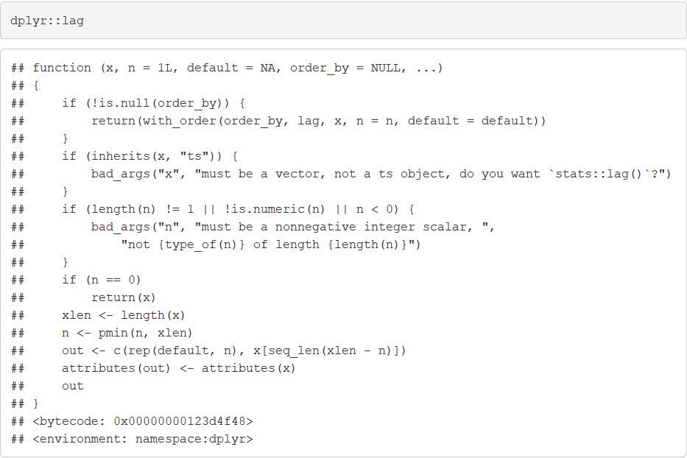
Built-in R Functions

Slide 5
Creating R Functions
General Form:
Functions are Objects in R
To Call Function:
Create an Object to Save an Output from a Function
NAME = function(INPUTS){
ACTIONS
return(OUTPUT)
}
NAME(INPUTS)
OUTPUT=NAME(INPUTS)

Slide 6
Creating R Functions
Example: Lag Operator
Used for Vectors According to Time (i.e Time Series Data)
Suppose a Vector Contains Information at Time = t
A Lagged Vector Contains Information at Time = t-k where k = Lag
Suppose y_{t} = Value of a Car at Time t. Then, y_{t-k} = Value of a Car at Time t-k

Slide 7
Creating R Functions
Example: Lag Operator
Vector of Values (in Thousands)
Lagged Values for k=1
Lagged Values for k=2
Want to Create a Function that:
Inputs Vector (x) and Lag (k)
Returns Lagged Vector
V = c(35, 32, 30, 31, 27, 25)
LV1 = c(NA, 35, 32, 30, 31, 27)
LV2 = c(NA, NA, 35, 32, 30, 31)

Slide 8
Creating R Functions
Example: Lag Operator
Attempt 1:
Attempt 2:
Uptown.Func1 = function(x, k=1){
t = length(x)
y = c(rep(NA,t))
for(i in (k+1):t){
y[i] = x[i-k]
}
return(y)
}
Uptown.Func2 = function(x,k){
t=length(x)
y1=x[1:(t-k)]
y2=c(rep(NA,k),y1)
return(y2)
}

Slide 9
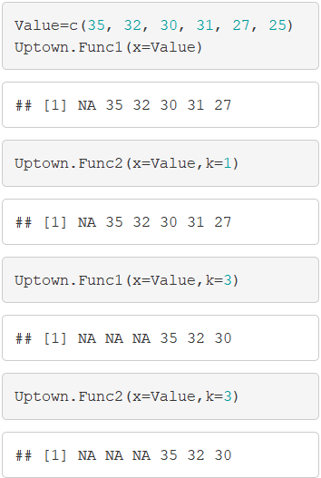
Creating R Functions
Example: Lag Operator

Slide 10
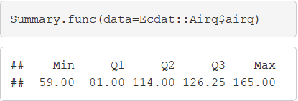
Practicing Functions
Computing Five Number Summary
Input Vector of Observations
Output Vector of Statistics
Summary.func = function(data){
min=min(data)
max=max(data)
q1=quantile(data,0.25)
q2=quantile(data,0.5)
q3=quantile(data,0.75)
y=c(min,q1,q2,q3,max)
names(y)=c("Min","Q1","Q2","Q3","Max")
return(y)
}

Slide 11
Practicing Functions
T-Test for Population Mean
Concept:
Null: Average # of Hours Spent Watching TV per Day is ____ in the USA
Alt: Average # of Hours Spent Watching TV per Day is not ____ in the USA
Does Data Provide Evidence that Alt is True

Slide 12
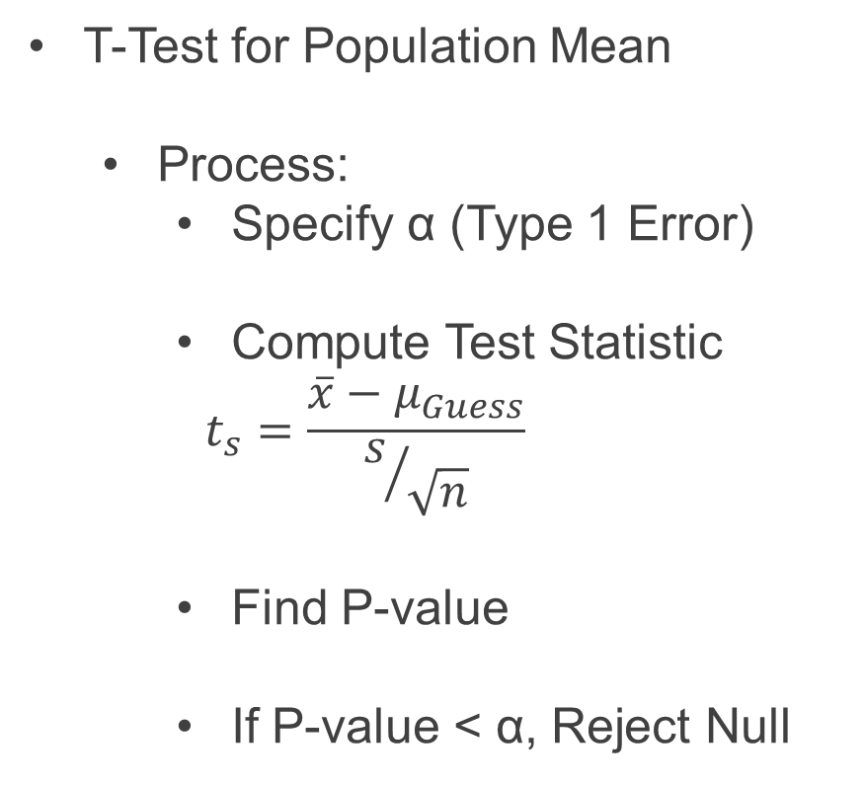
Practicing Functions
T-Test for Population Mean
Process:
Specify α (Type 1 Error)
Compute Test Statistic
$$t_{s}=\frac{\overline{x}−μ_{Guess}}{s/{\sqrt{n}}}$$
Find P-value
If P-value < α, Reject Null

Slide 13
Practicing Functions
T-Test for Population Mean
Inputs
Vector of Observations (ob)
Null Hypothesis (h0)
Alpha (a)
Output List
Test Statistic
P-value
Decision:
Reject
Fail to Reject
Plot Data and Null Guess

Slide 14
Practicing Functions
T-Test for Population Mean
Function in R
ttest = function(ob,h0,a){
n=length(ob)
ts=(mean(ob,na.rm=T)-h0)/(sd(ob,na.rm=T)/sqrt(n))
pval=2*pt(-abs(ts),df=n-1)
conclusion = if(pval<a){
"Reject Null Hypothesis"
} else{
"Fail to Reject Null Hypothesis"
}
plot=ggplot() +
geom_bar(aes(x=ob),fill="lightskyblue1") +
theme_minimal() + geom_vline(xintercept=h0)
return(list(ts=ts,pval=pval,
conclusion=conclusion,plot=plot))
}

Slide 15
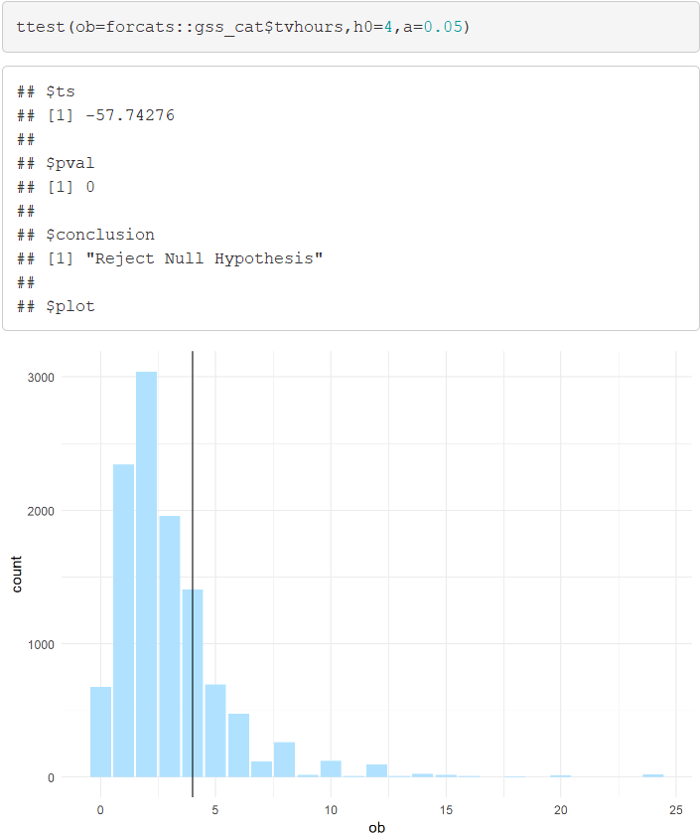
Practicing Functions
T-Test for Population Mean
Guess 4 Hours

Slide 16
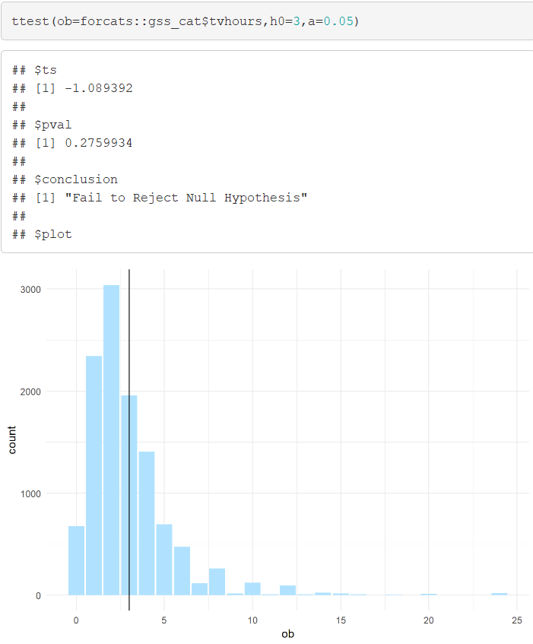
Practicing Functions
T-Test for Population Mean
Guess 3 Hours

Slide 17
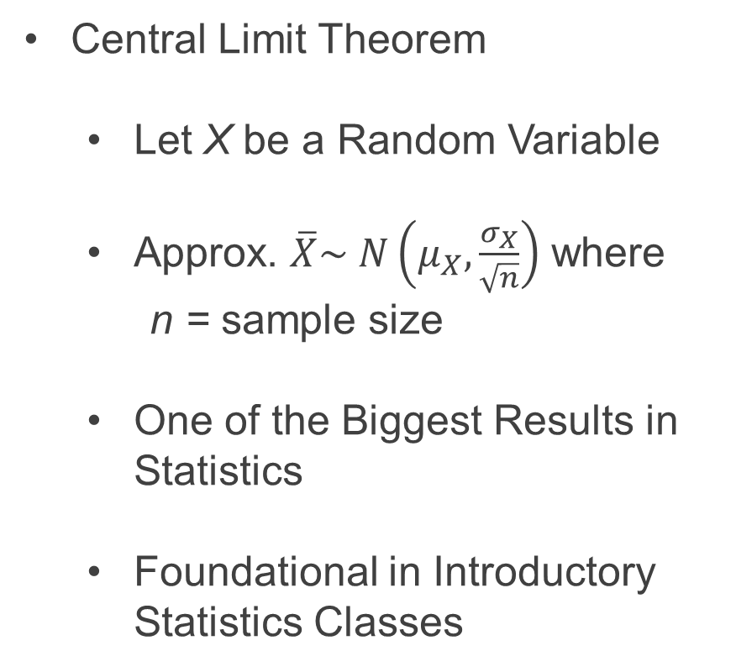
Practicing Functions
Central Limit Theorem
Let X be a Random Variable
Approx. $\overline{X}\sim N\left(μ_{X},\frac{σ_{X}}{\sqrt{n}}\right)$ where
n = sample size
One of the Biggest Results in Statistics
Foundational in Introductory Statistics Classes

Slide 18
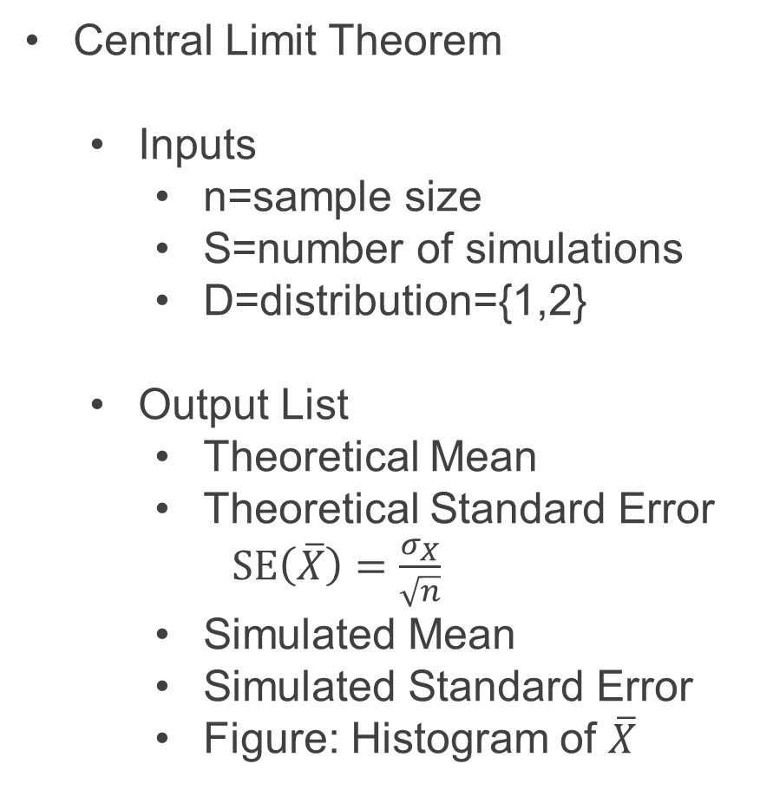
Practicing Functions
Central Limit Theorem
Inputs
n=sample size
S=number of simulations
D=distribution={1,2}
Output List
Theoretical Mean
Theoretical Standard Error
$SE\left(\overline{X}\right)=\frac{σ_{X}}{\sqrt{n}}$
Simulated Mean
Simulated Standard Error
Figure: Histogram of $\overline{X}$

Slide 19
Practicing Functions
CLT = function(n,S,D=c(1,2)){
if(D==1){
initial=rnorm(1000000)
} else if(D==2){
initial=rgamma(1000000)
}
t.mean=mean(initial)
t.se=sd(initial)/sqrt(n)
mean.sample=rep(NA,S)
for(k in 1:S){
if(D==1){
sample=rnorm(n)
} else if(D==2){
sample=rgamma(n)
}
mean.sample[k]=mean(sample)
}
s.mean=mean(mean.sample)
s.se=sd(mean.sample)
plot=ggplot()+
geom_histogram(aes(x=mean.sample),
fill=skyblue1)+theme_minimal()
OUT=list(theory.mean=t.mean,
theory.se=t.se,
sim.mean=s.mean,
sim.se=s.se,
plot=plot)
return(OUT)
}

Slide 20
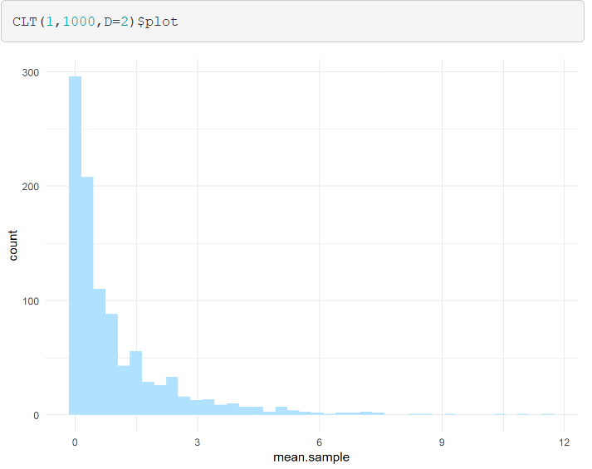
Practicing Functions
Central Limit Theorem
Plot of Gamma Population

Slide 21
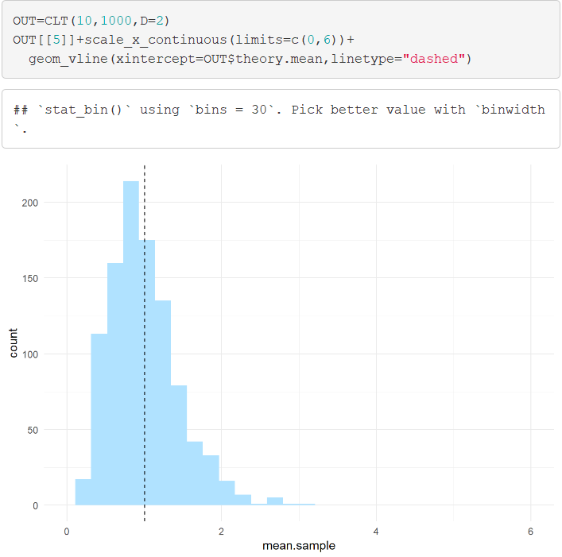
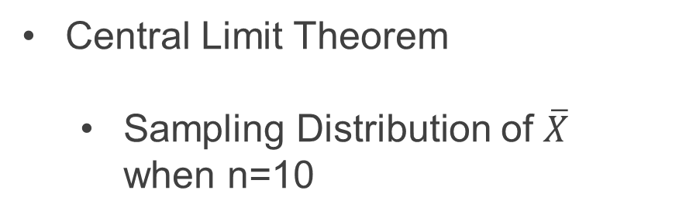
Practicing Functions
Central Limit Theorem
Sampling Distribution of $\overline{X}$ when n=10

Slide 22
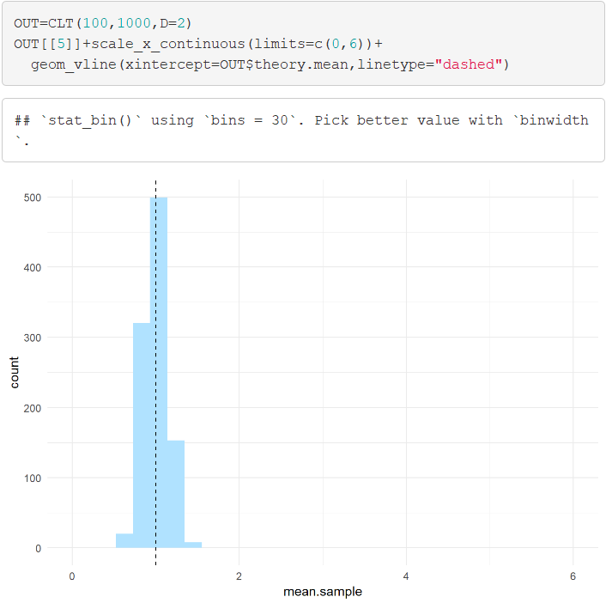
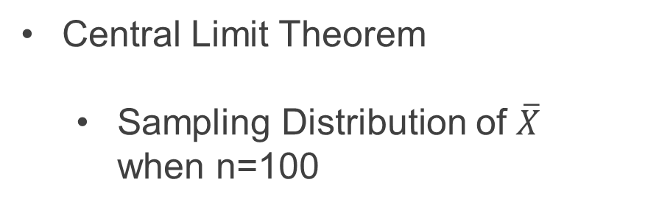
Practicing Functions
Central Limit Theorem
Sampling Distribution of $\overline{X}$ when n=100

Slide 23
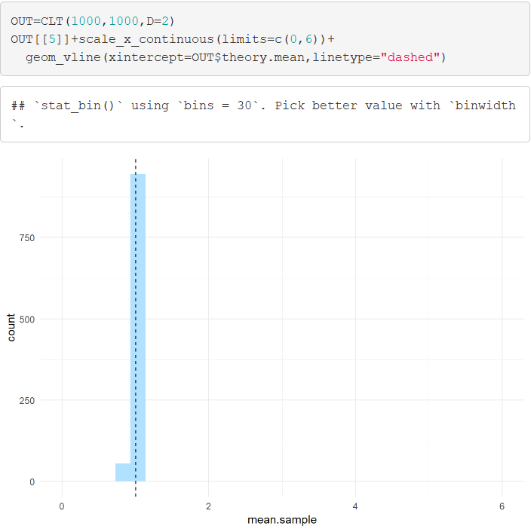
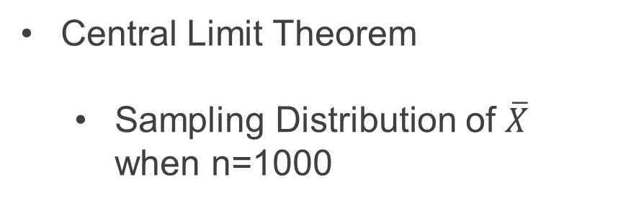
Practicing Functions
Central Limit Theorem
Sampling Distribution of $\overline{X}$ when n=1000

Slide 24
Closing
Disperse and Make Reasonable Decisions

